Slide 1

RESEARCH & REFERENCING

Slide 2
RESEARCH FINDINGS

Slide 3
Defining Research Findings
Research findings are the results or outcomes of a research study or investigation.
Research Findings represent the information, data, or conclusions that you have discovered through your research process.
Your research findings MUST be directly answering the research question in the task.

Slide 4
So, how do we research?
In summary, effective research involves a structured process of topic selection, information gathering, data analysis, and drawing well-supported conclusions.
Key Takeaways:
Choose a relevant and feasible research topic.
Evaluate sources for credibility.
Properly cite your sources to maintain academic integrity.

Slide 5

Primary vs Secondary Sources

Slide 6
Primary & Secondary Sources
Primary sources are original documents or data that you create yourself. Primary sources provide raw information and first-hand evidence. Examples include interview transcripts and statistical data (surveys, focus groups). A primary source gives you direct access to the subject of your research.
Secondary sources provide second-hand information and commentary from other researchers. Examples include journal articles, reviews, and academic books. A secondary source describes, interprets, or synthesizes primary sources.

Slide 7
What do you use primary sources for?
• Make new discoveries
• Provide credible evidence for your arguments
• Give authoritative information about your topic

Slide 8
What do you use secondary sources for?
• Gain background information on the topic
• Support or contrast your arguments with other researchers’ ideas
• Gather information from primary sources that you can’t access directly (e.g. private letters or physical documents located elsewhere)

Slide 9
Research Question (Assignment Task) Example
P1. Explain the role and responsibilities of Human Resource Management.
P2. Describe the different types of business systems and explain how they can lead to sustainability in an organization.
What would be your research question keys?

Slide 10

INTEXT CITATION

Slide 11
INTEXT CITATION
WHAT IS A CITATION?
A "citation" is the way you tell your readers that certain material in your work came from another source. It also gives your readers the information necessary to find that source again.

Slide 12
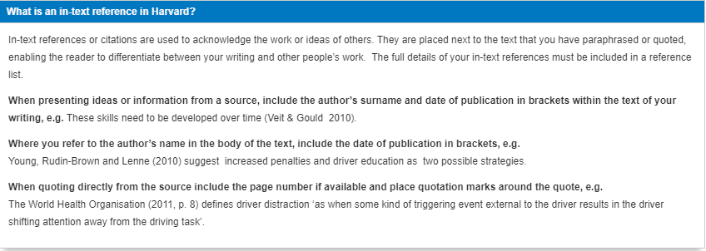
INTEXT CITATION EXAMPLES

Slide 13
INTEXT CITATION
WHY SHOULD I CITE SOURCES?
Giving credit to the original author by citing sources is the only way to use other people's work without plagiarizing. But there are a number of other reasons to cite sources:
citations are extremely helpful to anyone who wants to find out more about your ideas and where they came from
citing sources shows the amount of research you've done
citing sources strengthens your work by lending outside support to your ideas

Slide 14

WHEN DO I NEED TO CITE?
Whenever you borrow words or ideas, you need to acknowledge their source. The following situations almost always require citation:
whenever you use quotes
whenever you paraphrase
whenever you use an idea that someone else has already expressed
whenever you make specific reference to the work of another
whenever someone else's work has been critical in developing your own ideas.

Slide 15
Paraphrasing vs.
Summarizing vs.
Direct Quoting
Effective academic writing involves various techniques to incorporate information from sources into your work

Slide 16
Decide when to Quote, Paraphrase and Summarize
A quote is the exact wording of the source material (either written or spoken). Quotes match the original source word for word.
A paraphrase is a detailed restatement in your own words of a written or sometimes spoken source material. Apart from the changes in organization, wording, and sentence structure, the paraphrase should be nearly identical in meaning to the original passage. It should also be near the same length as the original passage and present the details of the original.
A summary is a condensed version of a passage. Similar to paraphrasing, summarizing involves using your own words and writing style to express another author's ideas. Unlike the paraphrase, which presents important details, the summary presents only the most important ideas of the passage.

Slide 17

Decide when to Quote, Paraphrase and Summarize
Whether quoting, paraphrasing, or summarizing, you should follow some general rules about integrating your source material.
Source material cannot make your points for you. Source material can back up your points or provide material for you to argue against; therefore, you will typically have to introduce source material and comment on how it helps prove your point. Essentially, source material has no significance without your commentary to provide context and meaning.
Always be faithful to the meaning of the source material that you include in your paper.
Cite appropriately and integrate the quote, paraphrase, or summary into the text effectively.
Quotes should be used RARELY in your work.

Slide 18
EXAMPLES USING A PASSAGE
Original Passage:
Source: Smith, J. (2020). The Impact of Climate Change on Coastal Ecosystems. Environmental Science Journal, 45(2), 123-137.
"Climate change is causing significant disruptions to coastal ecosystems worldwide. Rising sea levels, increased temperatures, and ocean acidification are some of the key factors affecting these ecosystems. These changes are having a profound impact on biodiversity, with many species facing the threat of extinction. Coastal communities are also vulnerable to the consequences of climate change, including more frequent and severe storms, coastal erosion, and loss of livelihoods."
Paraphrased Version:
Smith (2020) discusses the adverse effects of climate change on coastal ecosystems, which include disturbances such as elevated sea levels, heightened temperatures, and increased ocean acidity. These alterations significantly influence the diversity of species, putting many at risk of extinction. Additionally, coastal communities face vulnerabilities linked to climate change, including an increased occurrence of severe storms, shoreline erosion, and economic hardships.

Slide 19
EXAMPLES USING A PASSAGE
Original Passage:
Source: Smith, J. (2020). The Impact of Climate Change on Coastal Ecosystems. Environmental Science Journal, 45(2), 123-137.
"Climate change is causing significant disruptions to coastal ecosystems worldwide. Rising sea levels, increased temperatures, and ocean acidification are some of the key factors affecting these ecosystems. These changes are having a profound impact on biodiversity, with many species facing the threat of extinction. Coastal communities are also vulnerable to the consequences of climate change, including more frequent and severe storms, coastal erosion, and loss of livelihoods."
Summarized Version:
According to Smith (2020), climate change is causing disruptions to coastal ecosystems, including rising sea levels, temperature increases, and ocean acidification. These changes have a profound impact on biodiversity and threaten the existence of numerous species. Coastal communities are also at risk due to more frequent and severe storms, coastal erosion, and economic losses.

Slide 20
EXAMPLES USING A PASSAGE
Original Passage:
Source: Smith, J. (2020). The Impact of Climate Change on Coastal Ecosystems. Environmental Science Journal, 45(2), 123-137.
"Climate change is causing significant disruptions to coastal ecosystems worldwide. Rising sea levels, increased temperatures, and ocean acidification are some of the key factors affecting these ecosystems. These changes are having a profound impact on biodiversity, with many species facing the threat of extinction. Coastal communities are also vulnerable to the consequences of climate change, including more frequent and severe storms, coastal erosion, and loss of livelihoods."
Direct Quotation:
As Smith (2020) emphasizes, "Climate change is causing significant disruptions to coastal ecosystems worldwide. Rising sea levels, increased temperatures, and ocean acidification are some of the key factors affecting these ecosystems. These changes are having a profound impact on biodiversity, with many species facing the threat of extinction. Coastal communities are also vulnerable to the consequences of climate change, including more frequent and severe storms, coastal erosion, and loss of livelihoods" (p. 125).

Slide 21
REFERENCE LIST

Slide 22
WHAT IS A REFERENCE LIST?
Your Reference list should be located on a separate page at the end of your assignment and titled: References. It should include the full details of all your in-text citations, arranged alphabetically A-Z by author surname. The terms ‘Bibliography’ and ‘References’ are often used interchangeably, however a Reference list only includes items you have referenced in your assignment whereas a Bibliography also includes items used to prepare your assignment.

Slide 23
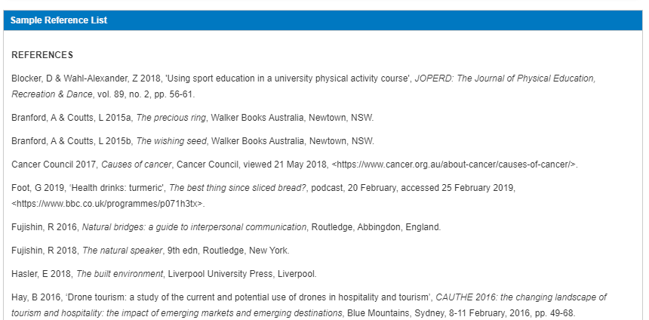

Slide 24
Difference between In-Text Citations and a Reference List
A reference list is a comprehensive list of all the sources you've consulted, presented in a specific format at the end of your document, while in-text citations are brief references within the body of your text that link back to the corresponding entries in the reference list. Together, they ensure proper attribution and citation of sources, contributing to the transparency and integrity of your academic writing.

Slide 25
PLAGIARISM & ETHICS

